Slide 1

Curiously Conquering 2021 Crime
Researched and compiled by
The Curious Conquerors
-Alisha -Mischa -Lindsay
Southern Careers Institute by WozU

Slide 2




Meet the Curious Conquerors
Alisha
I am a mom of an 8 month old and another on the way. My children’s father and I are engaged and plan to be married in October.
I currently work as a 911 dispatcher. I am originally from Florida, and then lived in Colorado, Idaho, California, and now Texas.

Slide 3
Meet the Curious Conquerors
Lindsay
At Home: I was born and raised in a small town in Northern Iowa. My hometown is where I still reside. I am close to my family and friends. I do not have children, just 3 dogs and a lot of plants.
Personally: I am shy, creative, intuitive, and loves doing anything hands on.
At work: I work in customer service. I know how to communicate effectively to coworkers and managers when necessary.
My future: I have always had a drive for technology and have plans to pursue a technology based career down the road.

Slide 4
Meet the Curious Conquerors
Mischa
First meet
Nervous, Shy, goofy, fast
At work
I am known to be every team’s go-to training and know-how expert.
Direct, formal, confident
At Home
I inspire my two daughters
by modeling:
Student
Family Member
Fulfilling Career
Motivation
Love for information and a better understanding of data to improve life.

Slide 5
Why investigate unemployment rates on crime?
Alisha works as a 911 dispatcher
No data from BCSO
Tons of data online

Slide 6
Methods

Slide 7
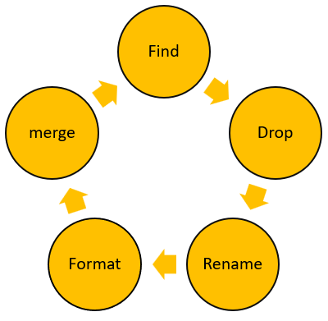

Extraction and Preparation

Slide 8

Analytics
Descriptive
Statistical
Modeling
R studios, python, tableau

Slide 9

Visualizations
R
Python
Tableau

Slide 10
Results

Slide 11
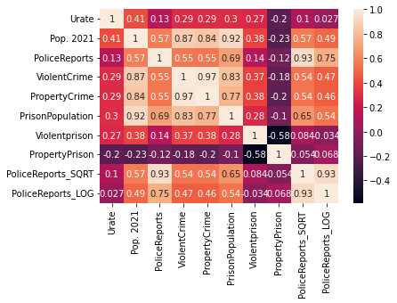
Correlation Chart
Population correlates with violent crime, property crime, and prison population.
Violent crime correlates with population , property crime and prison population.
As the violent crime goes up, property crime goes down.

Slide 12
Are unemployment rates correlated with crime rates?
Pearson’s Regression in python
Unemployment rate had a very weak correlation with police reports at 3%

Slide 13
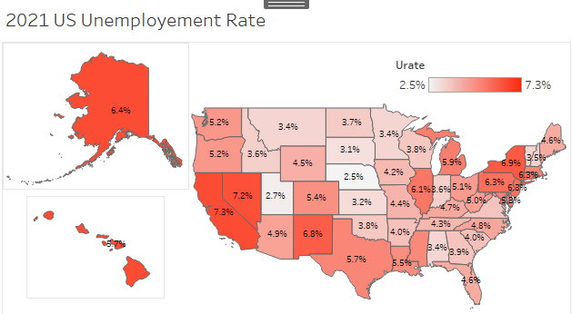
Unemployment rate vs Crime rate
Texas with significantly high unemployment rate
Texas and Florida with significantly high police reports

Slide 14
How does the unemployment rate affect the correlation between police reports and prison rates?
Step Wise Linear Regression in R
Unemployment has a slightly significant effect on prison population but not police reports.

Slide 15
Summary
Unemployment rates do not have significant affect on any of our data
We did find that as the violent crime increases, the property crime decreases
As population and police reports increased, prison population also increases

Slide 16
Conclusion
We enjoyed working on this project as a team and as individuals
Showing our abilities to use various platforms to wrangle and analyze the data we found
Ultimately, the results we found weren’t too surprising at were generally what you would expect to find.

Slide 17
This is just the beginning!
Time
State Size
Politics
Health Care

Slide 18
Questions?

